Slide 1
Viva Presentation
By Dean Ford

Slide 2
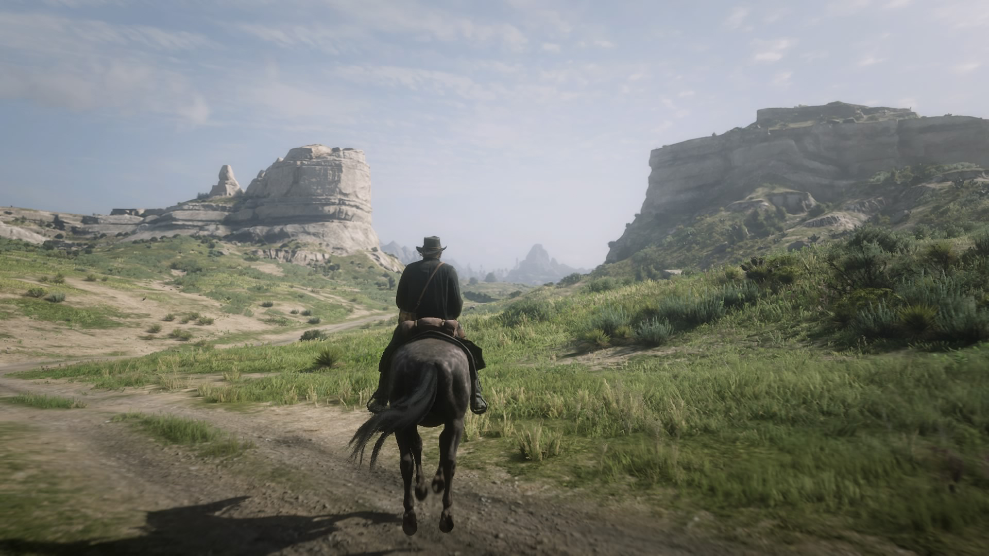
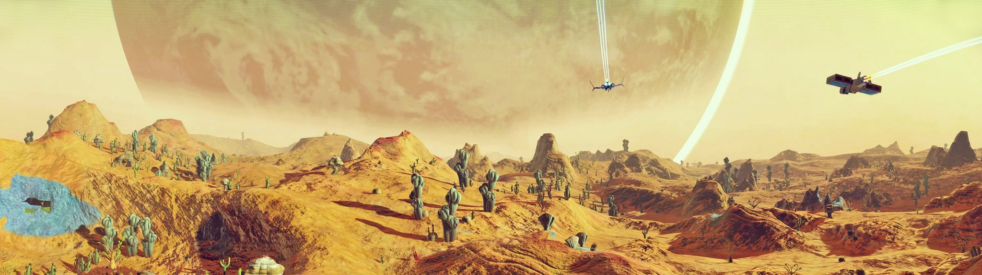
Terrain in video games
No Man Sky by Hello Games(2016)
Red Dead Redemption 2 by Rockstar Games(2018)
Procedurally generated
Modelling software
Flickr
Fitzpatrick, P. (2018).

Slide 3
Project outline
Research the topics to do with terrain generation, fluid simulation algorithms and erosion algorithms.
Create a random terrain generator in the Unity engine.
Implement a fluid and erosion algorithm into the Unity engine.
Create options to allow for customization of how the terrain is initially generated, how the water flows into the terrain, and the extent at which the erosion affects the terrain.
Test the performance of the simulation to ensure it is able to run in real time.
Compare visual results with existing algorithms based on similar programs or different types of algorithms.

Slide 4
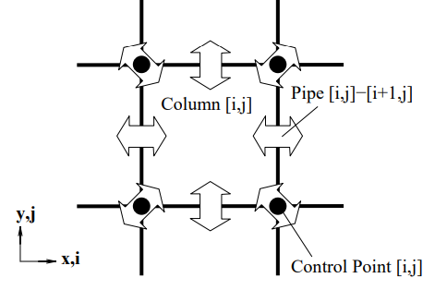
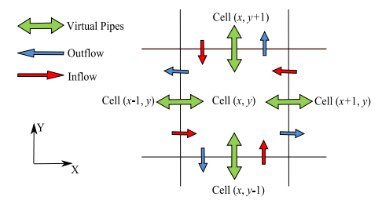
Fluid Simulation
Pipe model first discovered by James O’Brien and Jessica K. Hodgins in 1995
Improved by Xing Mei, Phillippe Decaudin and Bao-Gang Hu in 2007
Improvements - GPU implementation
O’Brien, J.F. and Hodgins, J.K. (1995)
Mei, X., Decaudin, P. and Hu, B. (2007)..

Slide 5
Erosion Algorithm
Sediment Transport Capacity of Overland Flow P.Y. Julien and D.B. Simons in 1985
Material Slippage by Ondrej St’ava, Bedrich Benes, Matthew Brisbin and Jaroslav Krivanek in 2008

Slide 6
Simulation Flow
Starts with Generating Textures, Mesh and shaders
Simulation
Updating Shaders
Initialize each texture required
Generate Mesh
Generate Heightmap
Initialize Shaders and update
Adding water
Updating flux
Water movement
Update velocity
Erosion
Transportation
Evaporation
Generate Normal Map
Using custom shader
Vertex displacement for mesh
Calculate lighting using normal map
Colours based on amount of water in certain locations

Slide 7

Generating Heightmap
Perlin noise by Ken Perlin (1985)
Simplex noise by Ken Perlin (2001)
Simplex noise is faster
Can generate 3-Dimensional noise
Used multiple times in the same position to create extra minute detail
Serw. (2008)

Slide 8
Adding Water
Rain
Randomly distributes rain based on randomly generated numbers
Water Source
Given a position
Adds water based on a given radius
Height based water
Places water based on height of mountains

Slide 9
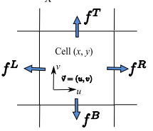


Updating flux
$$f_{t + ∆t}^{L}=max(0, f_{t}^{L}+ ∆t∗A∗ \frac{g∗ {∆h}^{L}}{l})$$
$$K=min(1, \frac{d∗l}{\left(f^{L}+ f^{R}+ f^{T}+ f^{B}\right)∗ ∆t})$$
Mei, X., Decaudin, P. and Hu, B. (2007)..

Slide 10


Water movement
$$∆V= ∆t ∗(\sum{f_{in}}−\sum{f_{out}})$$
$$d_{2}= d_{1}+ \frac{∆V}{l}$$

Slide 11

Compute velocity
$$v_{x}= W_{x} / lw$$
$$W_{x}= \frac{1}{2}[f^{R}\left(x−1, y\right)− f^{L}\left(x, y\right) +f^{R}\left(x, y\right)− f^{L}\left(x+1, y\right) ]$$

Slide 12

Erosion
$$C= K_{c}∗\sin\left(α\right)∗|v|$$
If C > current sediment held
some sediment is dissolved
If C < current sediment held
some sediment is deposited to terrain
Amount dissolved or deposited is determined by an individual scalar value

Slide 13

Transportation
Semi-Lagrangian advection method introduced by Jos Stam
$$s(x, y)=s(x−u∗ ∆t, y − v∗ ∆t)$$
Takes closest position to take sediment from that location

Slide 14

Evaporation
$$d=d∗(1− K_{e}∗ ∆t)$$
K = scalar for amount evaporated each time step

Slide 15
Elements used
Render textures – terrain, water, sediment, velocity, and flux
Most of the simulation is completed in compute shaders
Thread groups of 32 were used

Slide 16
Editable values
Noise Generation
Terrain Values
Simulation
Octaves
Lacunarity
Scale
Weight scaler
Map size
Scale
Elevation
Animate water
Water increase
Evaporation scale
Sediment capacity
Dissolving constant
Deposition constant

Slide 17
Quantitative Analysis
Graphics card used | Resolution
 | 640x640 | 960x960 | 1280x1280 | 1920x1920 | 3840x3840
RTX 2080 | 0.00451ms | 0.00466ms | 0.00706ms | 0.01505ms | 0.06273ms
RTX 2060 | 0.00475ms | 0.00652ms | 0.01132ms | 0.02487ms | 0.09714ms

Slide 18
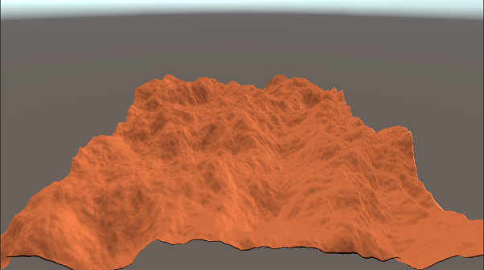
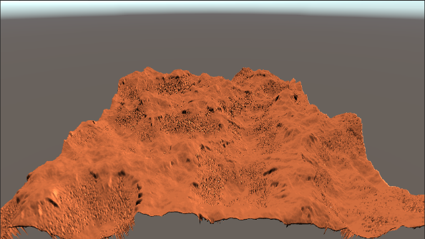
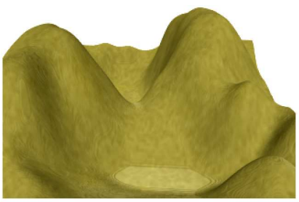
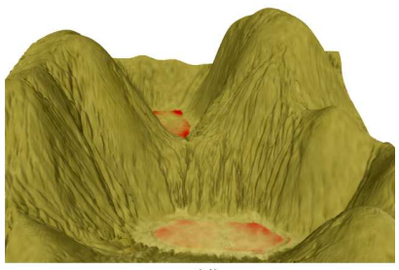
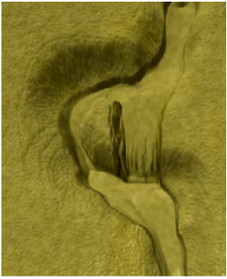
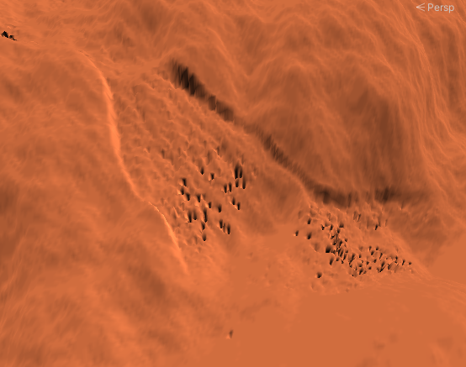
Qualitative Analysis
Mei, X., Decaudin, P. and Hu, B. (2007)

Slide 19
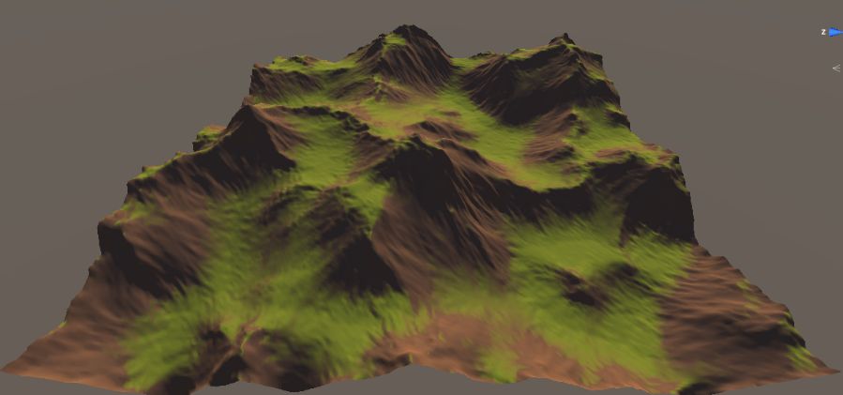
Mei, X., Decaudin, P. and Hu, B. (2007)
Lague, S. (2019)

Slide 20
SIMULATION DEMO

Slide 21
References
Mei, X., Decaudin, P. and Hu, B. (2007). Fast Hydraulic Erosion Simulation and Visualization on GPU. [online] Available at: https://ieeexplore.ieee.org/abstract/document/4392715.
Serw. (2008). Simplex noise. https://en.wikipedia.org/wiki/Simplex_noise
Lague, S. (2019). Hydraulic-Erosion. [online] GitHub. Available at: https://github.com/SebLague/Hydraulic-Erosion.
O’Brien, J.F. and Hodgins, J.K. (1995). Dynamic simulation of splashing fluids. [online] IEEE Xplore. Available at : https://ieeexplore.ieee.org/stamp/stamp.jsp?tp=&arnumber=393532.
Perlin, K. (1985). An image synthesizer. ACM SIGGRAPH Computer Graphics, 19(3), pp.287–296. Available at: https://doi.org/10.1145/325165.325247.
Perlin, K. (2002). Improving noise. Proceedings of the 29th annual conference on Computer graphics and interactive techniques. pp.681-682 Available at: https://doi.org/10.1145/566570.566636.
Flickr. (N/A). NMS Panorama 50. Pinterest. Available at: https://www.pinterest.co.uk/pin/109775309652211086/.
Fitzpatrick, P. (2018). Red Dead Redemption II - the good, no bad and no ugly. [online] The Chronicle. Available at: https://chronicle.durhamcollege.ca/2018/11/red-dead-redemption-ii-the-good-no-bad-and-no-ugly/.
Julien, PY. and Simons, DB. (1985). Sediment Transport Capacity of Overland Flow. Transactions of the ASAE. [online]. Available at: https://www.engr.colostate.edu/~pierre/ce_old/Projects/Paperspdf/Julien-Simons-ASAE85.pdf.
St'ava, O., Benes, B., Brisbin, M. and Krivanek, J. (2008). Interactive Terrain Modeling Using Hydraulic Erosion. [online] Available at: https://cgg.mff.cuni.cz/~jaroslav/papers/2008-sca-erosim/2008-sca-erosiom-fin.pdf.

